Slide 1
CS 575
Design and Analysis of
Computer Algorithms
Professor Michal Cutler
Greedy method

Slide 2
This class
Greedy method
  Problems
  Main idea
Activity selection
Greedy 0/1 knapsack with fractions

Slide 3
The problems
The problems have a set of items, some constraints on the solution and an objective function
The goal is to find an optimal solution (A subset of the items that satisfies the constraints and produces an optimal solution)
We need algorithms that provide an optimal solution (maximum or minimum) for all possible inputs
We are not satisfied with algorithms that provide optimal values only for some inputs

Slide 4
The Greedy Method
Greedy algorithms make “good” local choices that satisfy the constraints and hopefully provide an optimal solution for all inputs
  They are efficient, and easy to design and implement,
  Unfortunately they may provide optimal solutions only for some inputs
  In fact for some other inputs they may provide a very poor solution
A proof is needed to show that the algorithm finds an optimal solution for all inputs.
A counter example shows that the greedy algorithm does not provide an optimal solution for all inputs.

Slide 5
Pseudo-code for Greedy Algorithm
set Greedy (Set Candidate){
solution= new Set( );
while (Candidate.isNotEmpty()) {
next = Candidate.select(); //use selection criteria,
//remove from Candidate and return value
if (solution.isFeasible( next)) //constraints satisfied
solution.union( next);
if (solution.solves()) return solution}
//No more candidates and no solution
return null
}

Slide 6
Pseudo code for greedy cont.
select() chooses a candidate based on a local selection criteria, removes it from Candidate, and returns its value.
isFeasible() checks whether adding the selected value to the current solution can result in a feasible solution (no constraints are violated).
solves() checks whether the problem is solved.

Slide 7
Elements of the Greedy Strategy
Cast problem as one in which we make a greedy choice and are left with one subproblem to solve.
To show optimality:
Prove there is always an optimal solution to original problem that makes the greedy choice.

Slide 8
Elements of the Greedy Strategy
2. Demonstrate that what remains is a subproblem with property:
If we combine the optimal solution of the subproblem with the greedy choice we have an optimal solution to original problem.

Slide 9
Activity Selection
Given a set S of n activities with start time s_{i} and finish time f_{i} of activity i
Find a maximum size subset A of compatible activities (maximum number of activities).
Activities are compatible if they do not overlap
Can you suggest a greedy choice?

Slide 10
Example
Activities
1
2
3
4
5
6
7
11 13
2 12
3 10
11 15
3 7
1 4
0 2
Time
0 1 2 3 4 5 6 7 8 9 10 11 12 13 14 15

Slide 11
Counter Example 1
Select by start time
Activities
1
2
3
11 15
1 4
0 15
Time
0 1 2 3 4 5 6 7 8 9 10 11 12 13 14 15

Slide 12
Counter Example 2
Select by minimum duration
Activities
1
2
3
8 15
1 8
7 9
Time
0 1 2 3 4 5 6 7 8 9 10 11 12 13 14 15

Slide 13
Counter Example 3
Compute for each activity its maximum number of conflicts at any given time.
Select next activity by minimum number of conflicts
X
1 3
5 7
9 11
12 14
Time
0 1 2 3 4 5 6 7 8 9 10 11 12 13 14 15
Activity X has the minimum number of conflicts. Solution with 3 instead of 4

Slide 14
Select by finishing time
Activities
1
2
3
4
5
6
7
11 13
2 12
3 10
11 15
3 7
1 4
0 2
Time
0 1 2 3 4 5 6 7 8 9 10 11 12 13 14 15

Slide 15
Activity Selection
Assume without loss of generality that we number the intervals in order of finish time. So f₁≤...≤f_{n}.
Greedy choice: choose activity with minimum finish time
The following greedy algorithm starts with A={1} and then adds compatible jobs. (Θ(n))
Θ(nlogn) when including sort

Slide 16
Greedy-Activity-Selector(s,f)
n <- length[s] // number of activities
A <- {1}
j <- 1 //last activity added
for i <- 2 to n //select
if s_{i} >= f_{j} then //compatible (feasible)
add {i} to A
j <- i //save new last activity
return A

Slide 17
Theorem (16.1 Cormen)
Consider any nonempty subproblem S_{k} and let a_{m} be an activity in S_{k} with the earliest finishing time.
Then a_{m} is included in some maximum size subset of mutually compatible activities of S_{k}

Slide 18
Proof (16.1 Cormen)
Let A_{k} be an optimal solution for S_{k}.
Let a_{j} be the activity in A_{k} with minimum finishing time.
If a_{j} = a_{m} we are done since a_{m} is in some optimal solution
Otherwise, let A_{k}’= A_{k} - {a_{j}} ∪ {a_{m}}
The activities in A_{k}’ are disjoint since a_{m} finishes (at or) before a_{j}
Since| A_{k}’ |=| A_{k} |, A_{k}’ is an optimal solution for S_{k} that includes a_{m}.

Slide 19
The 0/1 Knapsack problem
Given a knapsack with weight W > 0.
A set S of n items with weights w_{i} >0 and
benefits b_{i}> 0 for i = 1,…,n.
S = { (item₁, w₁, b₁ ), (item₂, w₂, b₂ ) ,
. . . , ( item_{n,} w_{n}, b_{n} ) }
Find a subset of the items which does not exceed the weight W of the knapsack and maximizes the benefit.

Slide 20
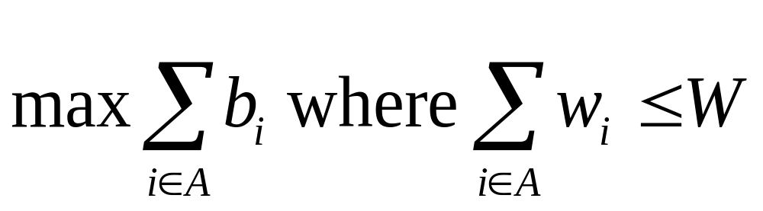
0/1 Knapsack problem
Determine a subset A of { 1, 2, …, n } that satisfies the following:
In 0/1 knapsack a specific item is either selected or not

Slide 21
Variations of the Knapsack problem
Fractions are allowed. This applies to items such as:
  bread, for which taking half a loaf makes sense
  gold dust
Integer values (no fractions).
  0/1 (1 brown pants, 1 green shirt…)
  0/any Allows putting many items of same type in knapsack
    5 pairs of socks
    10 gold bricks
More than one knapsack, etc.
First 0/1 integer knapsack problem will be covered then the 0/1 fraction knapsack problem (KWF).

Slide 22
0/1 integer knapsack
Brute force!
Generate all 2^{n} subsets
Discard all subsets whose sum of the weights exceed W (not feasible)
Select the maximum total benefit of the remaining (feasible) subsets
What is the run time?
O(n 2^{n}), Ω(2^{n})

Slide 23
Example with “brute force”
S = { ( item₁ , 5, $70 ), (item₂ ,10, $90 ), ( item₃, 25, $140 ) } , W=25
Subsets:
1. {}
2. { ( item₁ , 5, $70 ) } Profit=$70
3. { (item₂ ,10, $90 ) } Profit=$90
4. { ( item₃, 25, $140 ) } Profit=$140
5. { ( item₁ , 5, $70 ), (item₂ ,10, $90 )}. Profit=$160 ****
6. { (item₂ ,10, $90 ), ( item₃, 25, $140 ) } exceeds W
7. { ( item₁ , 5, $70 ), ( item₃, 25, $140 ) } exceeds W
8. { ( item₁ , 5, $70 ), (item₂ ,10, $90 ), ( item₃, 25, $140 ) } exceeds W

Slide 24
Possible Greedy Algorithms
Select:
  Maximun benefit
  Minimum weight
  Maximum benefit per unit of weight
  Other?
Counter examples
Problem becomes easier when we allow fractions

Slide 25
Greedy 1: Selection criteria: Maximum beneficial item.
Counter Example:
S = { ( item₁ , 5, $70 ), (item₂ ,10, $90 ), ( item₃, 25, $140 ) }
$140
10 lb
W = 25lb
$90
$140
$70
5 lb
25 lb
$70
25 lb
10 lb
$90
5 lb
10 lb
item₁
item₂
item₃
Knapsack
Greedy
Solution
=$140
Optimal
Solution
=$160

Slide 26
Greedy 2: Selection criteria: Minimum weight item Counter Example:
S = { ( item₁ , 5, $150 ), (item₂ ,10, $60 ), ( item₃, 20, $140 ) }
5 lb
$140
W =
30lb
$140
20 lb
$60
$60
20 lb
10 lb
$150
10 lb
$150
5 lb
$150
5 lb
5 lb
item₁
item₂
item₃
Knapsack
Greedy
Solution
=$210
Optimal
Solution
=$290

Slide 27
Greedy 3: Selection criteria: Maximum weight item
Counter Example:
S = { ( item₁ , 5, $150 ), (item₂ ,10, $60 ), ( item₃, 20, $140 ) }
5 lb
10 lb
$60
$140
W =
30lb
$140
20 lb
$60
20 lb
$150
10 lb
20 lb
$140
$150
5 lb
5 lb
item₁
item₂
item₃
Knapsack
Greedy
Solution
Optimal
Solution
=$200
=$290

Slide 28
Greedy 4: Selection criteria: Maximum benefit per unit item Counter Example
S = { ( item₁ , 5, $50 ), ( item₂, 20, $140 ) (item₃ ,10, $60 ), }
5 lb
B/W: $7
$140
W =
30lb
$140
20 lb
$140
B/W 2: $6
20 lb
B/W 1: $10
$60
20 lb
$50
10 lb
$60
10 lb
$50
5 lb
5 lb
item₁
item₂
item₃
Knapsack
Greedy
Solution
=$190
Optimal
Solution
=$200
What is the asymptotic runtime of this algorithm?

Slide 29
An Optimal Greedy Algorithm for 0/1 Knapsack with Fractions (KWF)
The following algorithm provides the optimal benefit:
The greedy algorithm uses the maximum benefit per unit selection criteria
  1. Sort items in non-increasing (or decreasing) b_{i} / w_{i}.
  2. Add items to knapsack (starting at the first) until there are no more items, or the next item to be added exceeds W.
  3. If knapsack is not yet full and there are more items , fill knapsack with a fraction of next unselected item.

Slide 30
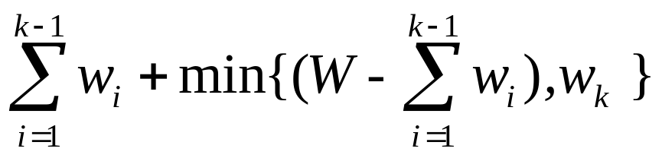
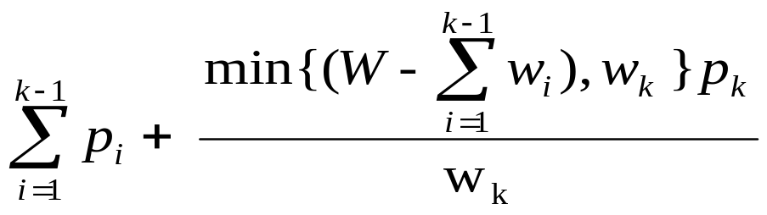
KWF
Let k be the index of the last item included in the knapsack. We may be able to include the whole or only a fraction of item k
totweight =
profitKWF =
min{(W – sum of first k-1),w_{k} }, means that we either take the whole of item k when the knapsack can include the item without violating the constraint, or we fill the knapsack by a fraction of item k

Slide 31
Example of applying the optimal greedy algorithm for Fractional Knapsack Problem
S = { ( item₁ , 5, $50 ), ( item₂, 20, $140 ) (item₃ ,10, $60 ), }
B/W: $7
5 lb
5/10 * $60 = $30
$140
30lb
Max
Optimal
benefit $220
Solution:
items 1and 2
and 1/2 of
item 3
$140
B/W 2: $6
20 lb
B/W 1: $10
$60
20 lb
$50
10 lb
$50
5 lb
5 lb
item₁
item₂
item₃
Knapsack
Greedy
Solution
=
Optimal
Solution

Slide 32
0/1 integer knapsack
We will use a backtracking algorithm and KWF to provide an upper bound and prune the state space tree

